Slide 1

Deep Learning 101: Apache MXNet
Sergey Sokolov, AWS AI
26 July 2018
www.globalbigdataconference.com
Twitter : @bigdataconf
#GBCC
©2018 Amazon Web Services, Inc. or its affiliates, All rights reserved

Slide 2

Self-introduction: Sergey Sokolov
AWS AI
Software Developer

Slide 3
Agenda

Slide 4
Situating Deep Learning
Can machines think?
Can machines do what we can? (Turing, 1950)
AI
Machine Learning
Deep Learning
Data
Machine Learning
Answers
Rules

Slide 5
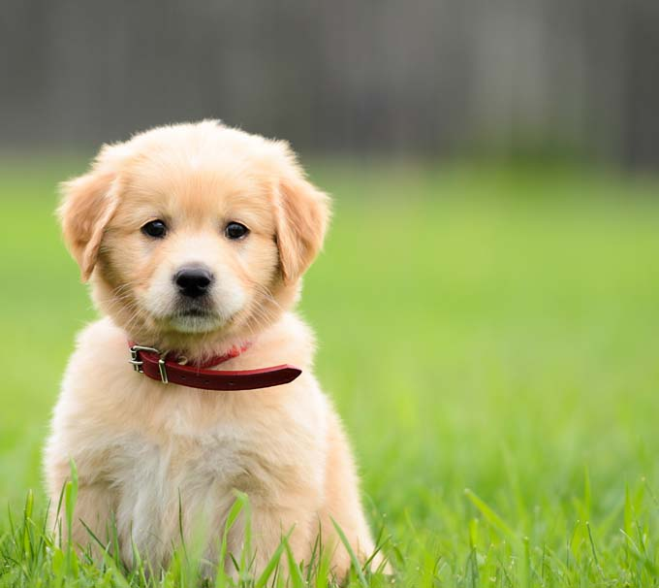


Why do machine learning?
How many cats?
Complex tasks where you can’t code up explicit solutions

Slide 6
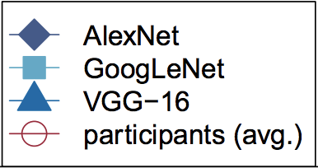
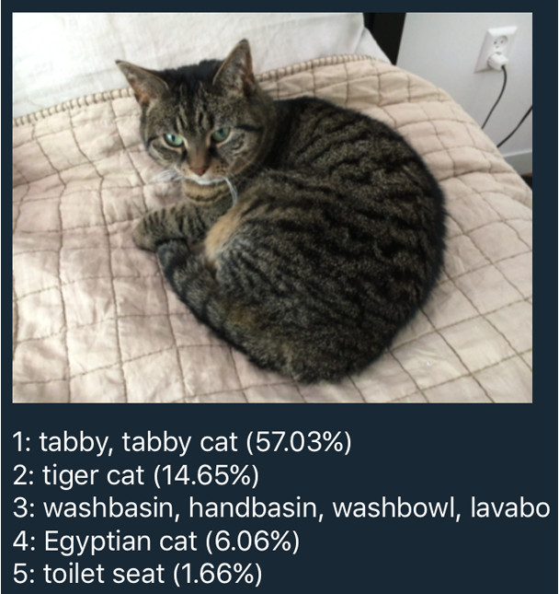
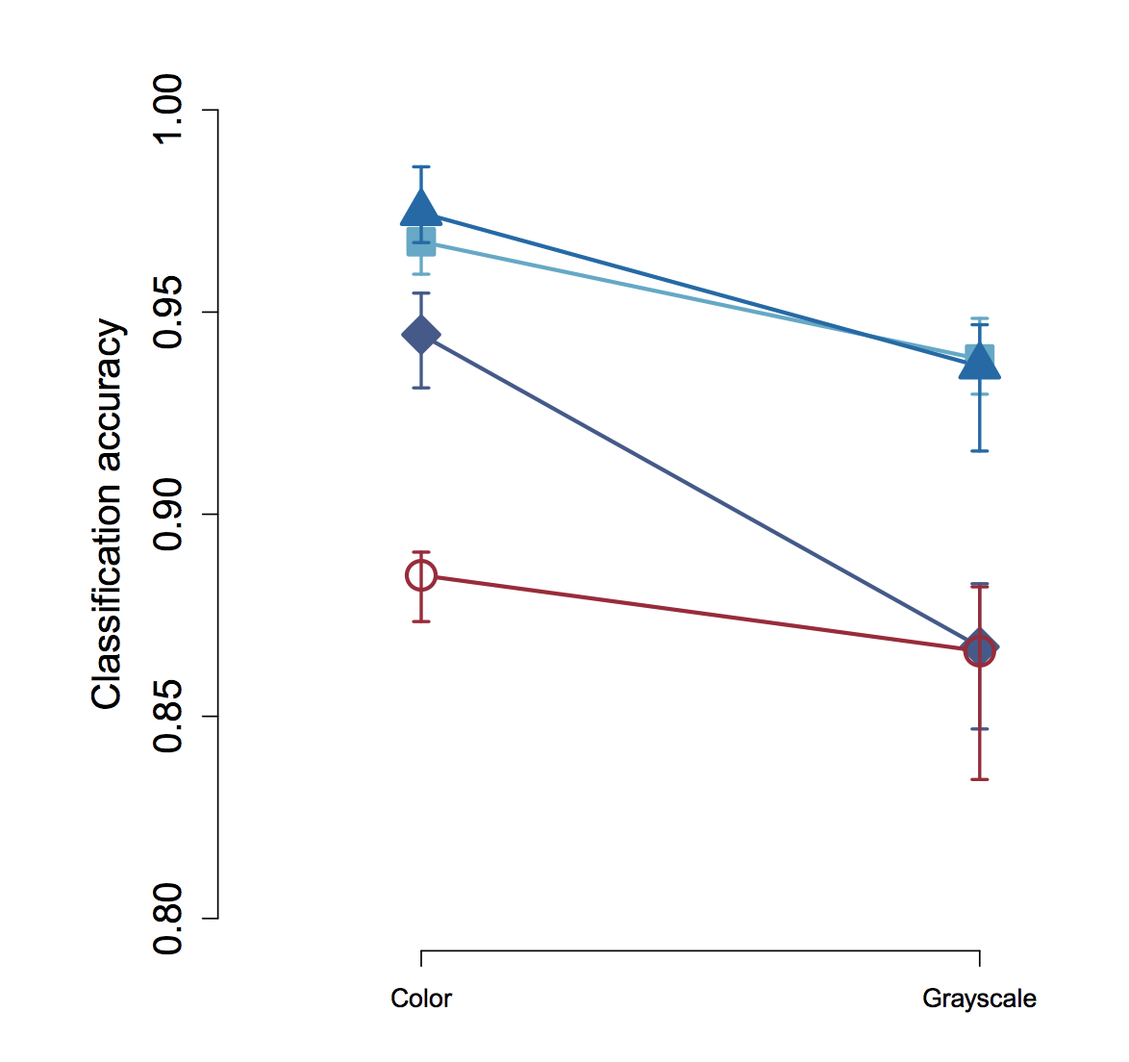
Why deep learning?
Deep NNs achieve Human-level or better performance

Slide 7
When not to use Deep Learning?
When a task can be easily solved with simpler tool
Finding USA Social Security numbers from text
There is an algorithm to achieve the result
Stripping suffixes off English words
Exact numerical solution required

Slide 8
Basic Terminology
Predict if a person earns >$50K
Age | Education | Years of education | Marital status | Occupation | Sex | Label
39 | Bachelors | 16 | Single | Adm-clerical | Male | -1
31 | Masters | 18 | Married | Engineering | Female | +1
Training examples (rows)
Input features / x
Label / ground truth / y

Slide 9
Basic Terminology
One-hot encoding to convert categorical features
Age | Education | Years of education | Marital status | Occupation | Sex | Label
39 | Bachelors | 16 | Single | Adm-clerical | Male | -1
31 | Masters | 18 | Married | Engineering | Female | +1
Age | Edu_Bachelors | Edu_Masters | Years of education | Marital_Single | … | Label
39 | 1 | 0 | 16 | 1 | … | -1
31 | 0 | 1 | 18 | 0 | … | +1

Slide 10
Types of Machine Learning
Supervised
Data & labels
Unsupervised
Data, no labels
Regression
Semi-supervised
Data, some labels
Active learning
Dimensionality reduction
Classification, Labeling
Clustering
Reinforcement learning

Slide 11
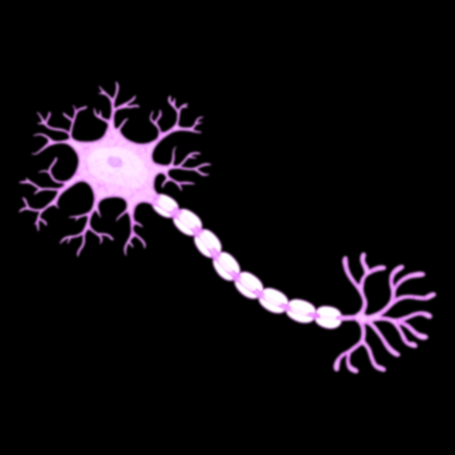
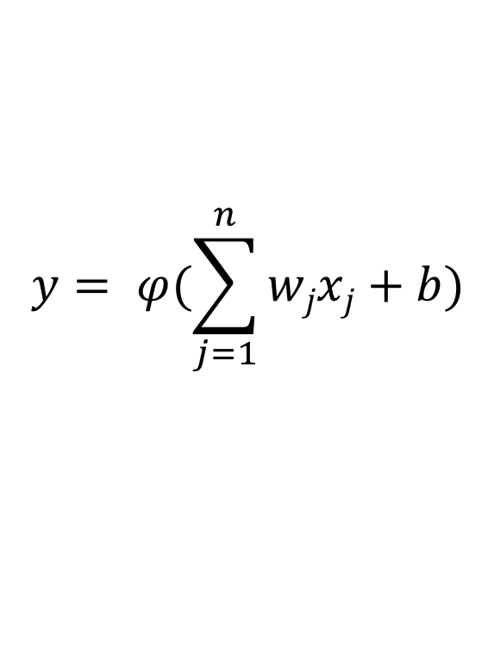
(Artificial) Neural Networks (ANN)
Inspired by the brain’s neurons
We have ~100B of them, and ~1Q Synapses
Inputs
Weights
Bias
Activation
b
x₁
w₁
$$y= φ(\sum_{j=1}^{n}{wjxj}+b)$$
Σ
φ
𝑦
x₂
w₂
…
x_{n}
w_{n}

Slide 12

Deep Neural Networks
Non-linear
Hierarchical feature learning
Scalable architecture
A Multilayer Perceptron (MLP)

Slide 13
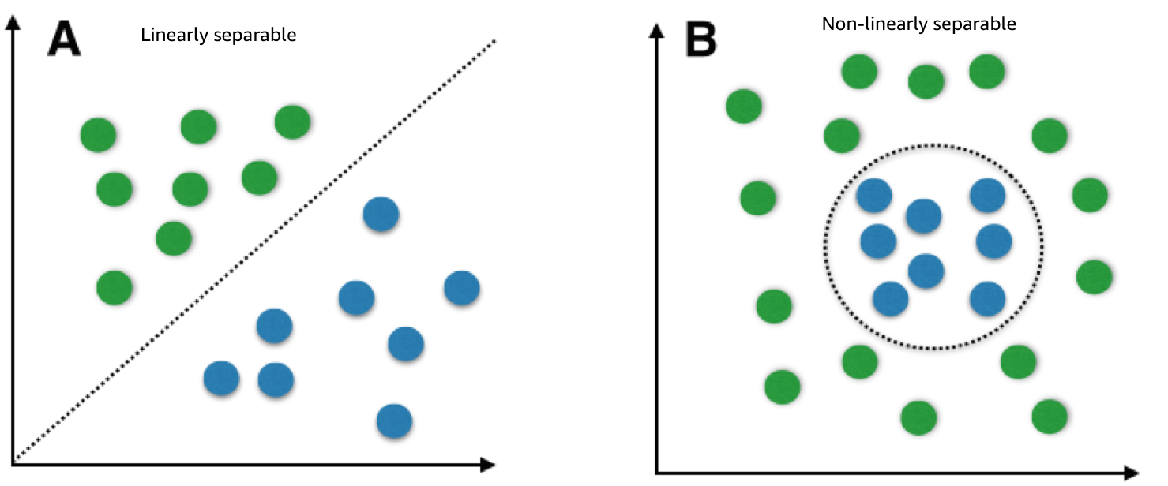
Linear and non-linear separability

Slide 14
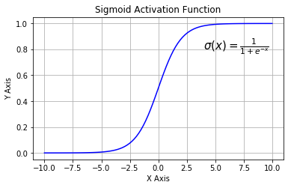
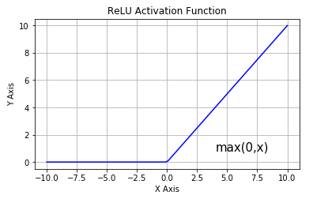
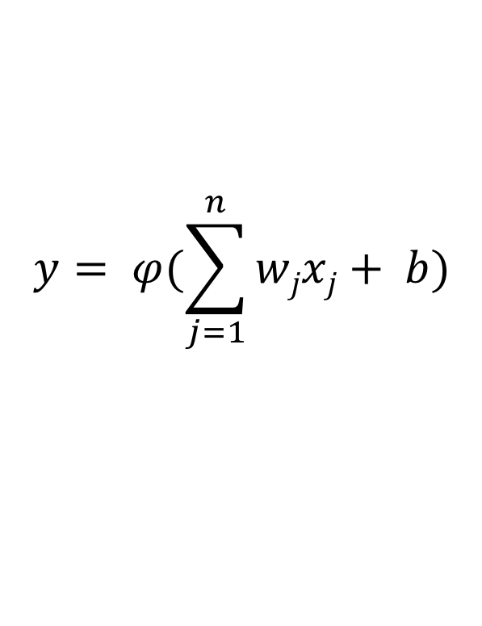
Activation Functions
$$y= φ(\sum_{j=1}^{n}{wjxj+ b)}$$
Determine how the neuron fires
Represent non-linearity

Slide 15

Bias term
Each neuron has a bias associated with it
Moves the activation left or right on x-axis
$$y= φ(\sum_{j=1}^{n}{wjxj+ b)}$$

Slide 16
Parameters and Hyperparameters
Parameters
Numeric values in the model: weights and biases
Learned during training
Hyperparameters
Values set for the training session
Numeric e.g. mini-batch size
Non-numeric e.g. which algorithm to use for optimization
Hyperparameter optimization
Outer layer of learning / searching for hyperparameters

Slide 17
Training to estimate parameters
One parameter per connection
One bias per neuron
Find the values that minimize the loss on training data

Slide 18
Accuracy vs. Loss
Accuracy: A percentage
Correct or not per example
Loss: calculated during training
How far off is the current model?
Continuous value
Common loss functions
Mean squared error (regression)
Cross entropy: log of difference in probability
During training, minimize loss with an optimizer

Slide 19
Basic Optimizer: Stochastic Gradient Descent
Init params. Choose learning rate
Divide data: train, validate, test. Shuffle training
For each training example:
Feed forward, calculate output
Compare to truth, calculate loss
Calc. gradient for loss for each parameter
$$param=param −learning_rate∙gradient$$

Slide 20

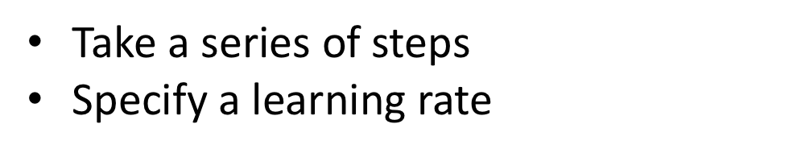
Stochastic Gradient Descent
$\text{Take} \text{a} \text{series} \text{of} \text{steps}$
$\text{Specify} \text{a} \text{learning} \text{rate}$

Slide 21
Demo 1: MLP

Slide 22
Introduction to Apache MXNet

Slide 23
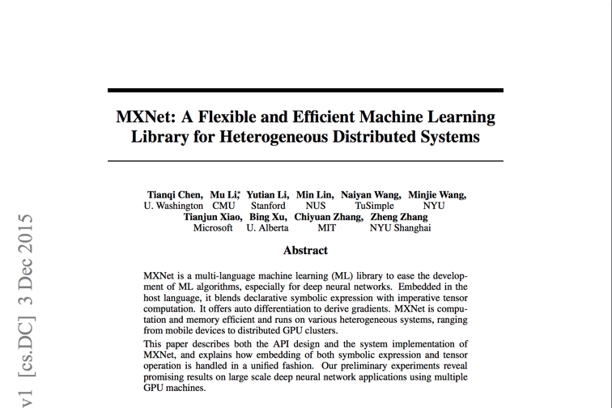
Original paper in Dec, 2015
https://arxiv.org/pdf/1512.01274.pdf

Slide 24

Major events
Amazon’s deep-learning framework of choice since November 2016.
Accepted into
Apache Incubator
in January 2017.

Slide 25


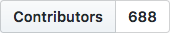
Highlights
Ease of Use
Flexible APIs
Performance
Optimized for CPU, GPU, ARM (and more)
Python, Scala, R, C++, Clojure, Julia, Perl
Examples and tutorials
Portability
Train on cloud, predict on edge
Highly scalable distributed training
ONNX support
Quantization, Sparse, NCCL, and more…
Model serving framework

Slide 26
Ecosystem
ONNX
Model Zoo
TVM
GluonCV
MXNet
Model Server
GluonNLP
MXBoard
Keras

Slide 27
Architecture of Apache MXNet

Slide 28
Separate frontend and backend
R
Perl
Julia
Clojure
Python
Scala
C++
Frontend
Backend
C++

Slide 29
Optimized libraries
CUDA & CUDNN
MLK, MKLML & MKLDNN
e.g. pip install mxnet-cu92
e.g. pip install mxnet-mkl
e.g. pip install mxnet-cu92mkl
Also Atlas, OpenBLAS & Apple Accelerate.

Slide 30
Asynchronous Engine
Operations appear to return immediately, but just pushed to engine queue on backend.
Allows for much greater parallelism.
Must wait_to_read() or similar to retrieve value and this blocks.
Sync
Async
backend
frontend
wait_to_read()

Slide 31
Python Core APIs
Module
(2016)
Gluon
(2017)
High Level APIs
Symbol
NDArray
Low Level APIs

Slide 32
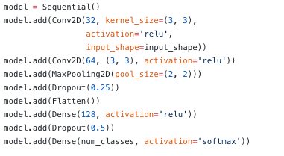
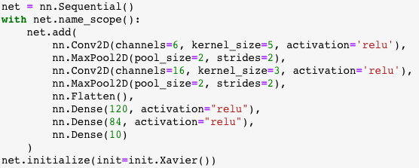
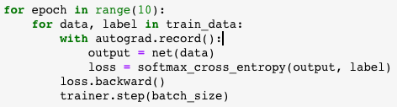
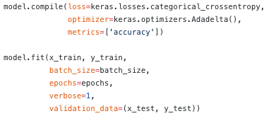
Symbolic vs Imperative
Symbolic is “define, compile, run”
Imperative is “define-by-run”

Slide 33
Hands on session

Slide 34

Community
http://mxnet.io
http://discuss.mxnet.io
https://github.com/apache/incubator-mxnet
/apachemxnet
@ApacheMXNet
@ApacheMXNet
/r/mxnet

Slide 35
Additional resources
Deep Learning - The Straight Dope
https://gluon.mxnet.io/
Deep Learning Toolkit for NLP
http://gluon-nlp.mxnet.io/
Deep Learning Toolkit for CV
https://gluon-cv.mxnet.io/
This presentation and tutorials
https://github.com/Ishitori/DeepLearningWithMXNetGluon

Slide 36
How to Get Started with MXNet on AWS
Amazon SageMaker: https://aws.amazon.com/sagemaker/
Using Apache MXNet with Amazon SageMaker: https://docs.aws.amazon.com/sagemaker/latest/dg/mxnet.html
Contact: mxnet-info@amazon.com

